Slide 1
Sentiment aNALYSIS
Basalam Dataset

Slide 2
Agenda
Preprocessing
Words feature engineering
Emoji Analysis
Essential words Analysis
TF-IDF Approach
ML Based Approach
Word Embedding _ml Approach
ParsBert Approach

Slide 3
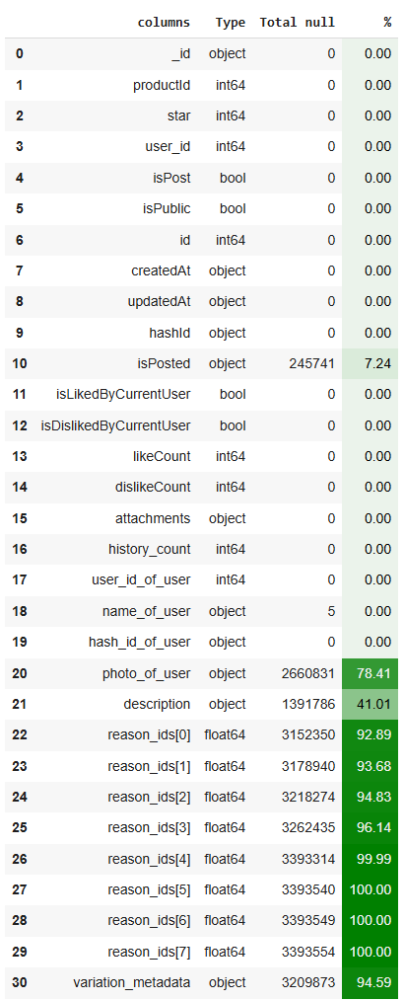
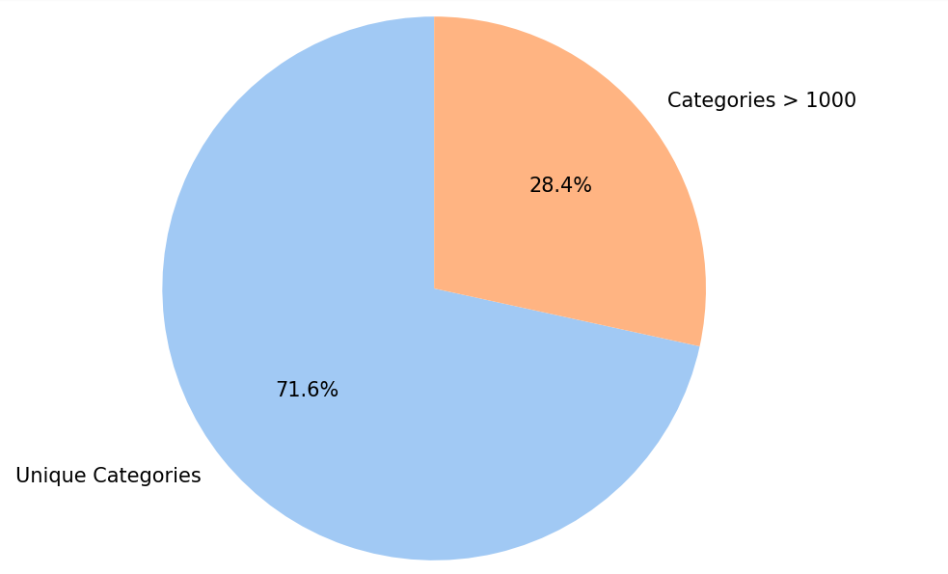
41%
We have 781 Unique categories which 310 of them are more than 1000
Null values

Slide 4
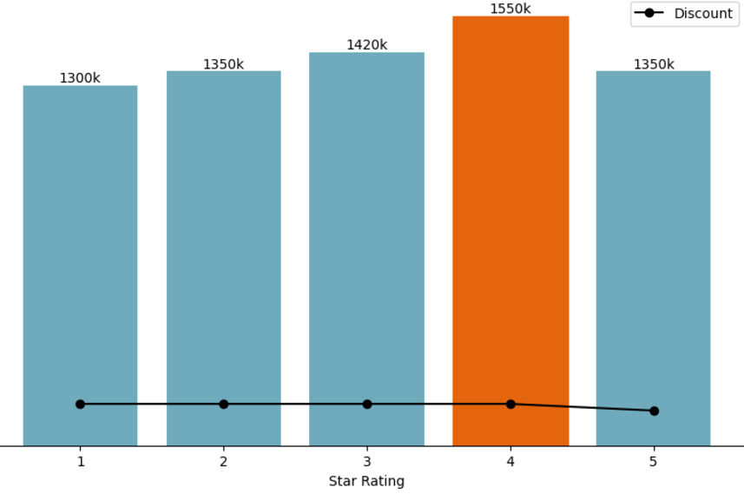
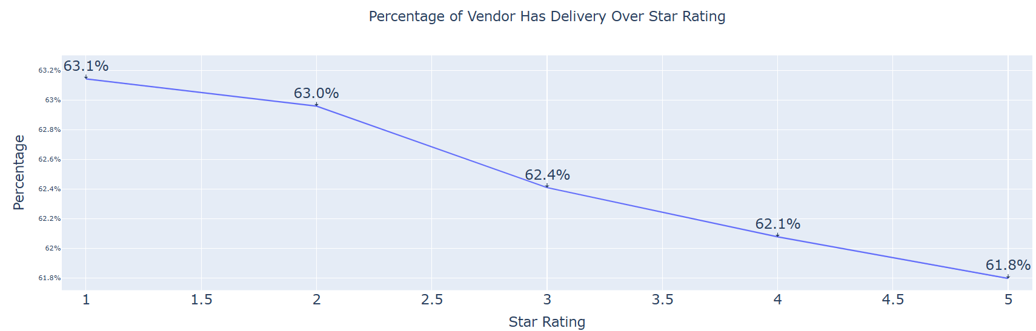
The median price of 4 star products are more than the others while products with 5 stars have more discount amount
There is no significant variation in vendors with delivery over stars

Slide 5
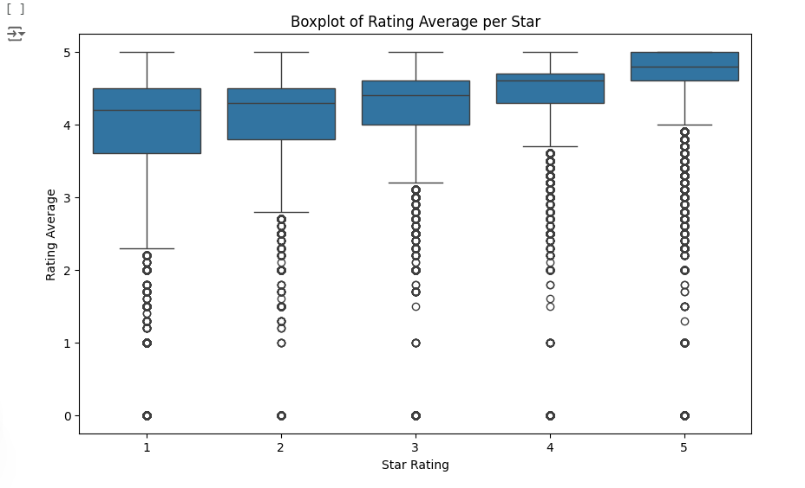

Slide 6
Emoji analysis
95.41%
Sad Unique emojis
Happy Unique emojis
10
7
440
Neutral Unique emojis

Slide 7
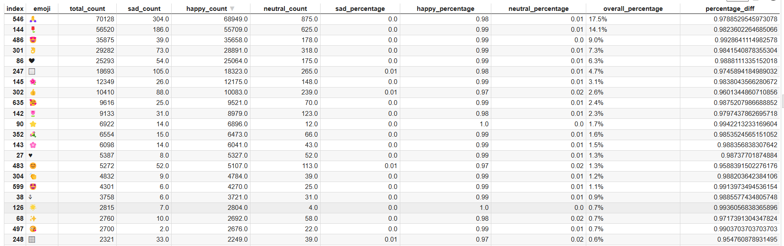
Emojis dataset

Slide 8
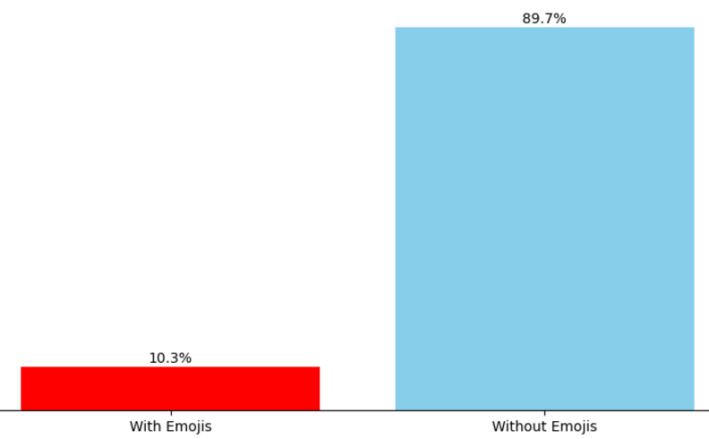
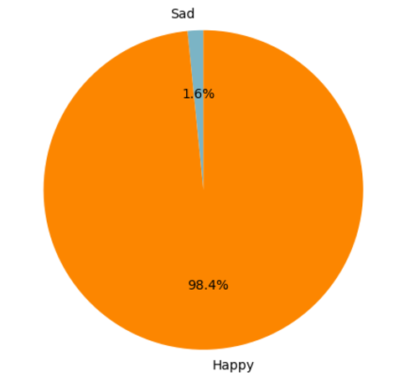
98% of all these emojis are happy
About 10% of all comments contains emojis
Average of character amount
77
The average length of characters in sad comments is 1.5 times greater
52

Slide 9
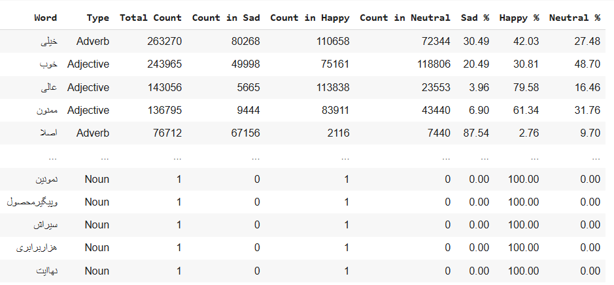
Essential words Analysis
Make lists of words that that have more than 60% chance of use for each Adj, Noun & Adverb

Slide 10
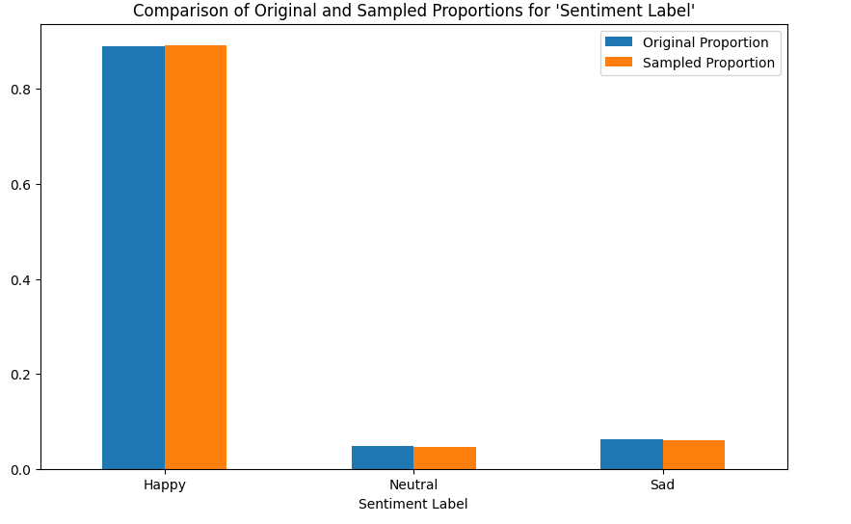
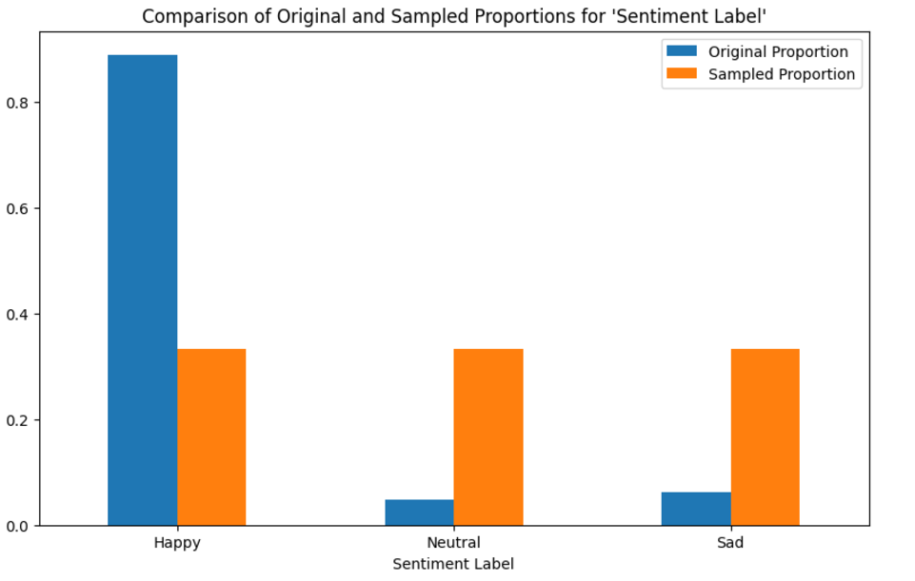
Making 2 samples 1. imbalanced 2. balanced

Slide 11
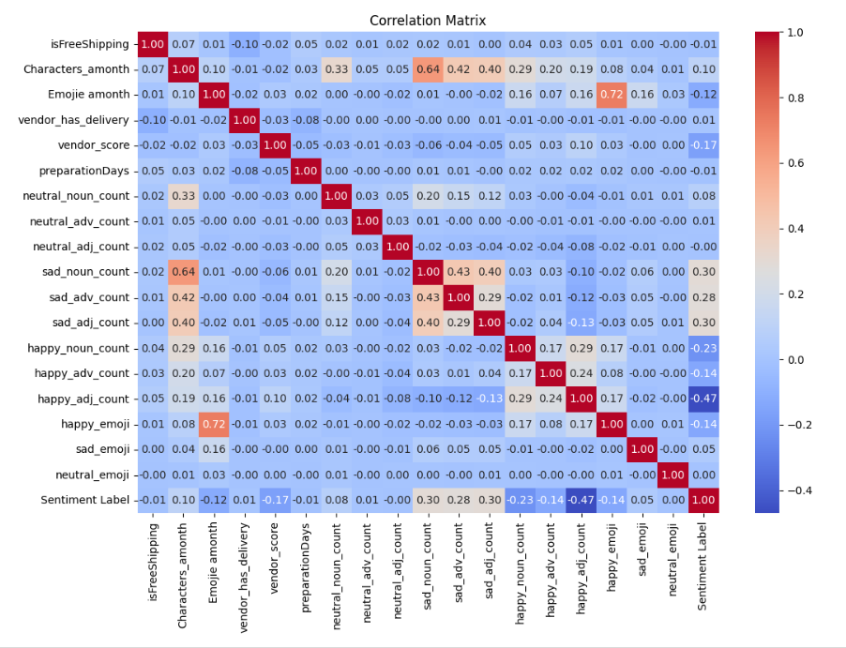
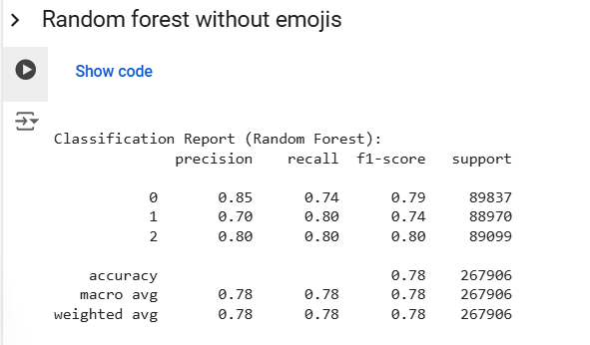
Make a data frame of Extracted features from comments
Make a data frame of Extracted features from comments

Slide 12
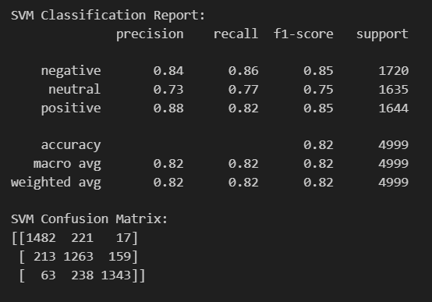
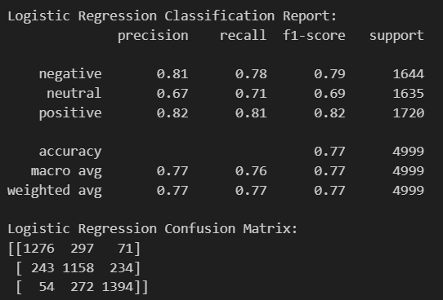
Using parsbert embeddings
Logistic Regression
SVM

Slide 13
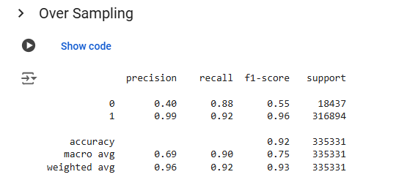
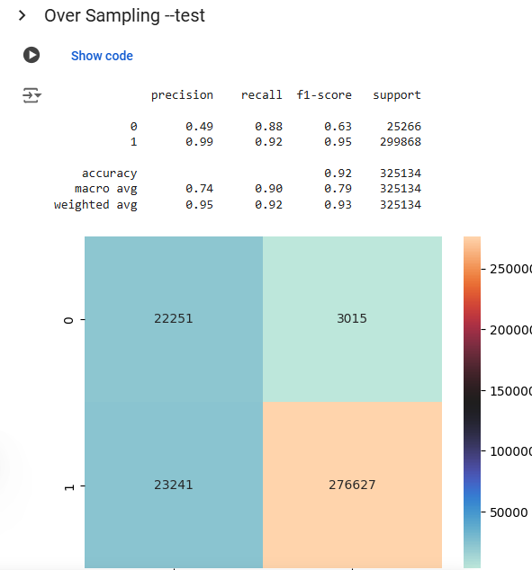
Imbalanced
TF-IDF with balance and imbalanced data

Slide 14
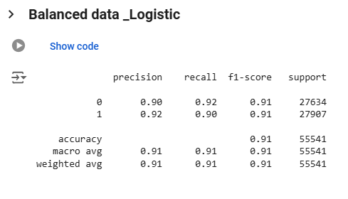
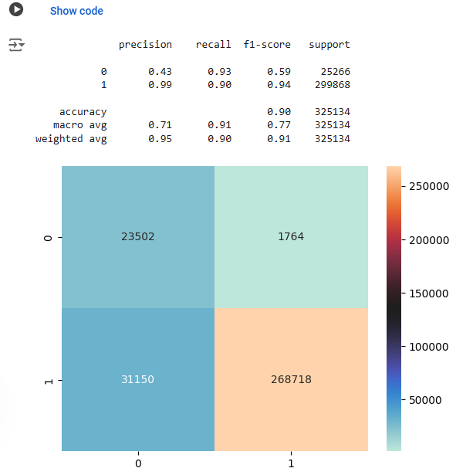
Balanced
TF-IDF with balance and imbalanced data

Slide 15
Imbalanced
TF-IDF with balance and imbalanced data

Slide 16
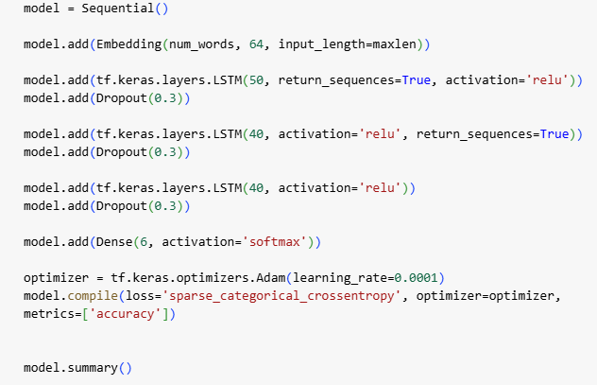
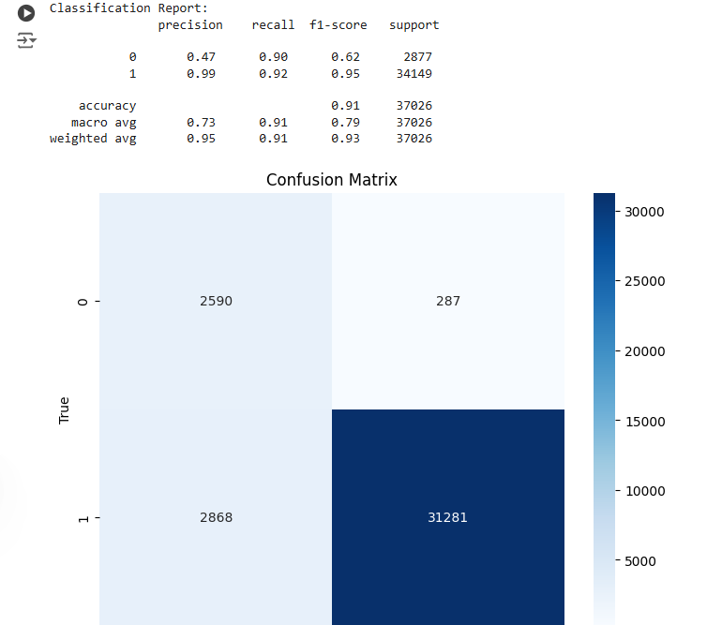
Balanced
TF-IDF with balance and imbalanced data

Slide 17
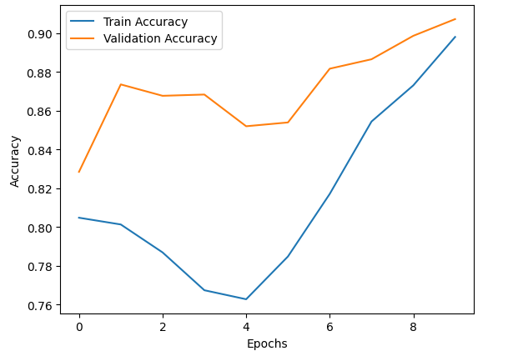
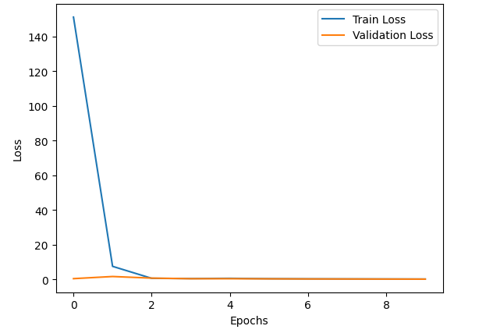

Slide 18
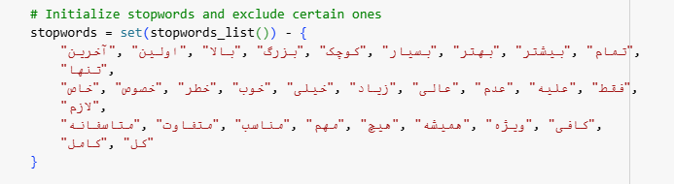
Balanced
TF-IDF with balance and imbalanced data

Slide 19
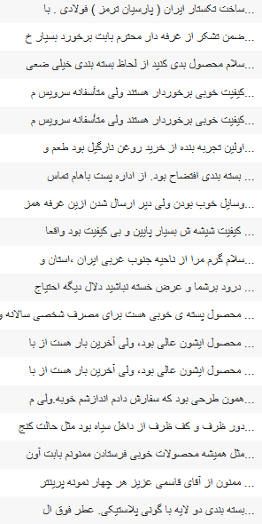
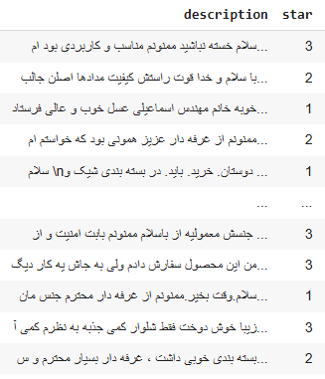
Label conflict
There are 230 comments with more than 3 happy adjectives with sad label
Also 50 comments with more than 3 sad adjective and happy label

Slide 20
parsBert-50K Imbalance
TF-IDF with balance and imbalanced data
Accuracy
90%
F1-score_happy:
neutral:
sad:
30
5
11
parsBert-50K Balanced
Accuracy
71%
F1-score_happy:
neutral:
sad:
76
56
76

Slide 21
